Slide 1
Object-Oriented using Java Course Introduction

Slide 2
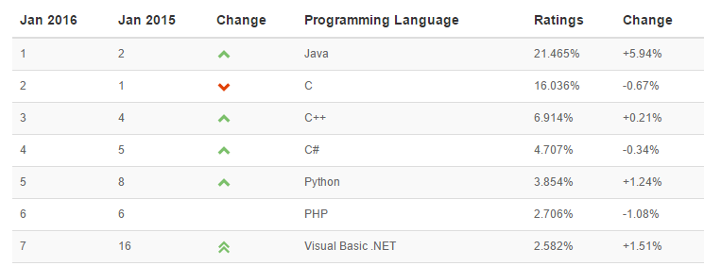
Why should you study Java?
Top ten common programming languages:
From http://www.tiobe.com/index.php/content/paperinfo/tpci/index.html

Slide 3
Why Java?
Java Is Architecture Neutral.
Java Provides “One-Stop Shopping”.
Java Is Object-Oriented from the Ground Up.
Practice Makes Perfect.
Java Is an Open Standard.
Java Is Free!
Notes:
1.platform independent -> this means that the java program can be run on any OS without considering its vendor. It is implemented by using the MAGIC CODE called "BYTE CODE". The JVM then either interprets this at runtime or uses JIT (Just in Time) compilation to compile it to machine code for the architecture that is being run on (e.g. i386).
2.architecture neutral -> it means the java program can be run on any processor irrespective of its vendor and architecture. so it avoids rebuilding problem.
3.portable -> a programming language/technology is said to be purely portable if it satisfies the above two features.
--------------
With most conventional programming language, the core language does not automatically provide everything that you’ll need in order to builder an industial strength application, with a graphical user interface and access DBMS. For these capabilities, you must typically intergrate platform specific libraties into your application
------------
The use of open standards can help provide interoperability and maximise access to resources and services. However this raises two questions: "Why open standards?" and "What are open standards?".

Slide 4
Course Overview
Prerequisite:
Programming Fundamentals Using C

Slide 5
Course objectives
Make you comfortable with fundamental object-oriented (OO) terminology and concepts.
Getting to know the “World of Java”.
Understand the implementation of a Java Application.
Understand the roles of java built-in packages.

Slide 6
Contents
Introduction
Foundations
Encapsulation
Inheritance
Polymorphism
Array of Objects
Collections in Java

Slide 7
Resources
Tool
NetBean IDE 8.x
JDK8
Text book
textbook on LMS
http://docs.oracle.com/javase/tutorial/
http://www.oracle.com/technetwork/java/javase/documentation/jdk8-doc-downloads-2133158.html

Slide 8
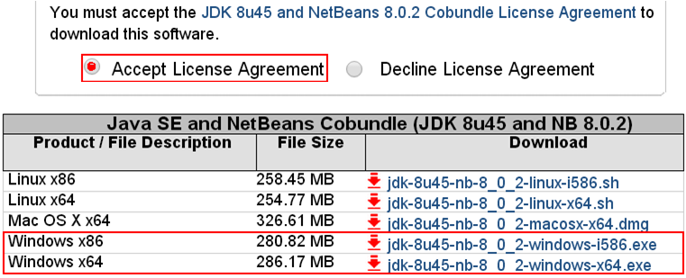
Download & Install JDK & NetBeans 8
http://www.oracle.com/technetwork/java/javase/downloads/jdk-netbeans-jsp-142931.html

Slide 9
Course Plan
See course plan on LMS

Slide 10
Course Requirements
Following lessons in classroom
Reading textbook and documents at home
Completing chapter assessment in time
Discussing actively in your teams and in classroom

Slide 11
Assessment Scheme
06 Labs (10%)
01 Assignment (20%)
02 Progress test (10%)
01 Practical Exam (30%)
Final Exam (30%)

Slide 12
Academic policy
Cheating, plagiarism and breach of copyright are serious
offenses under this Policy.
Cheating
Cheating during a test or exam is construed as talking, peeking at another student’s paper or any other clandestine method of transmitting information.
Plagiarism
Plagiarism is using the work of others without citing it; that is, holding the work of others out as your own work.
Breach of Copyright
If you photocopy a textbook without the copyright holder's permission, you violate copyright law.

Slide 13
Enjoy the course
Be enthusiastic about the material because it is interesting, useful and an important part of your training as a software engineer. Our job is to help you learn and enjoy the experience. We will do our best but we need your help. So let’s all have fun together with Object-Oriented Paradigm using Java.

Slide 14
Nguyễn Thanh Tú
Email: tunt57@fpt.edu.vn
Mobile: 0982 813 103

Slide 15
Q&A

